Slide 1

Management
Interfaces in OpenBMC

Slide 2
AGENDA
IPMI
Redfish
MCTP
PLDM
Use Cases in OpenBMC

Slide 3
IPMI
Legacy protocol for server management
Enables remote control of power, sensors, and logs
Works even when the main CPU is off (out-of-band management)
Uses KCS (local) and LAN (remote) for communication
Binary-based and hard to extend
Still supported in OpenBMC for compatibility
Lacks modern security (no encryption, weak auth)
Works with tools like ipmitool
OpenBMC runs an IPMI service (phosphor-ipmi-host)

Slide 4
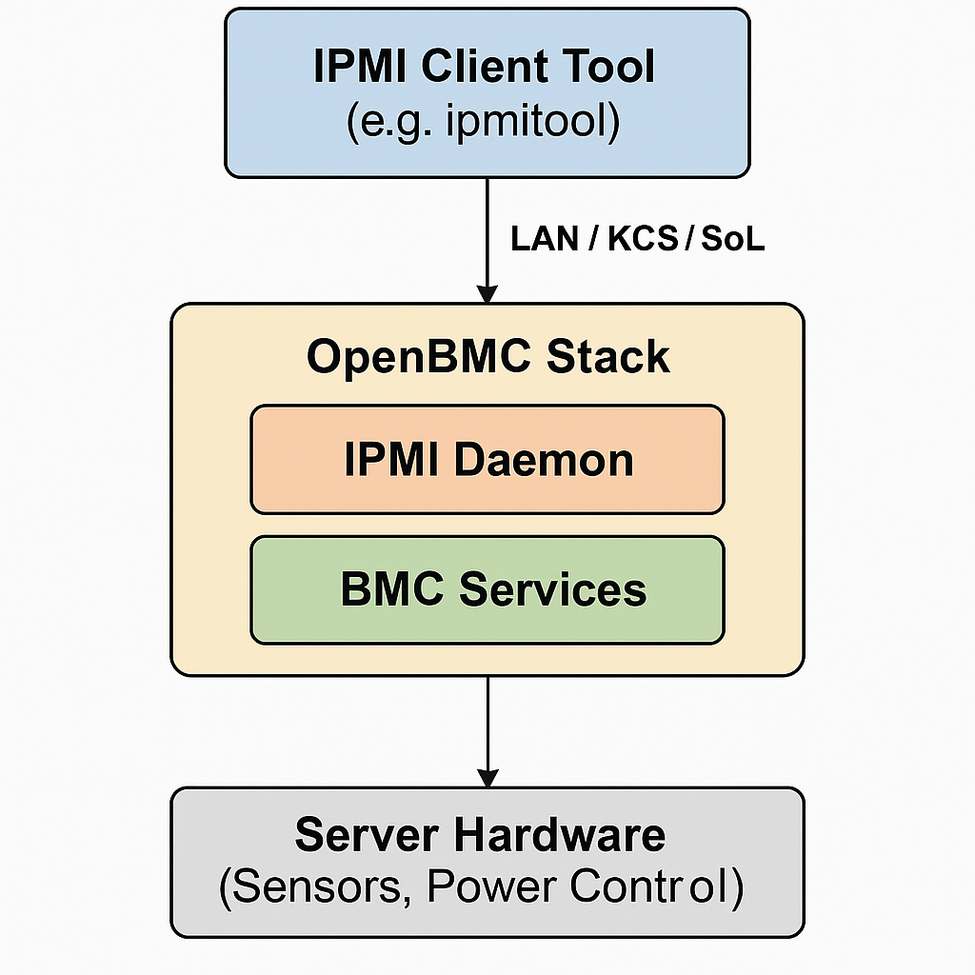
How IPMI Works in OpenBMC

Slide 5
RedFISH
Modern, RESTful API for hardware management
Developed by DMTF to replace IPMI
Uses HTTPS + JSON for secure and human-readable communication
Enables access to:
Power and reset control
BIOS settings and firmware updates
Sensor monitoring and inventory
Fully supported in OpenBMC via bmcweb
Easily integrated with automation tools (Ansible, OpenStack, etc.)

Slide 6
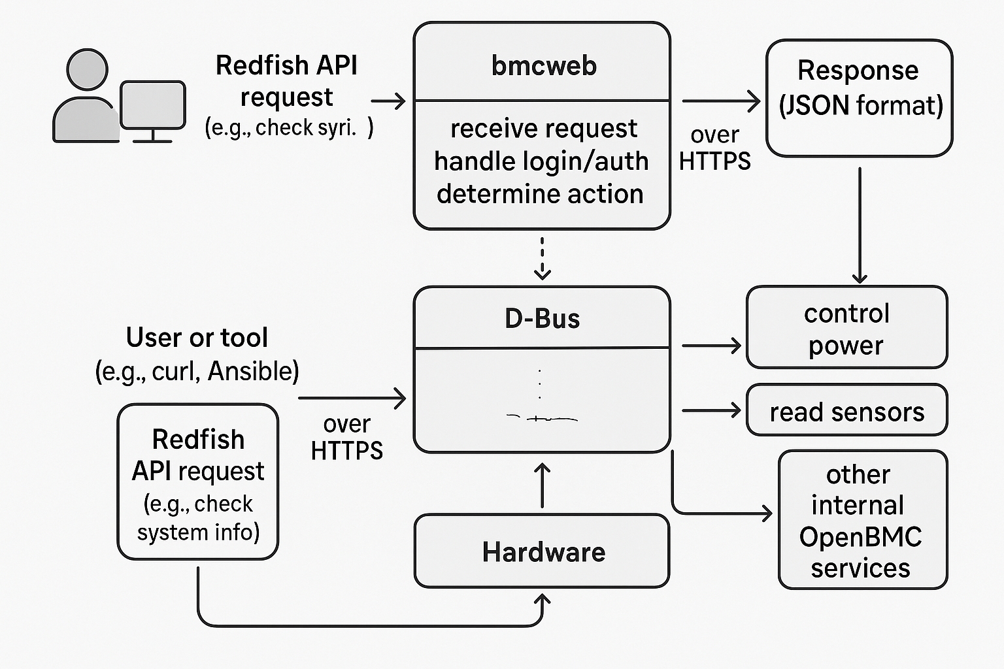
How Redfish Works in OpenBMC

Slide 7
PLDM
Platform Level Data Model (by DMTF)
Internal Communication Protocol
Efficient and Binary-Based
Supports Platform Management Tasks
Built on MCTP Transport
Standardized Data Models
Complements Redfish and Replaces IPMI Internals

Slide 8
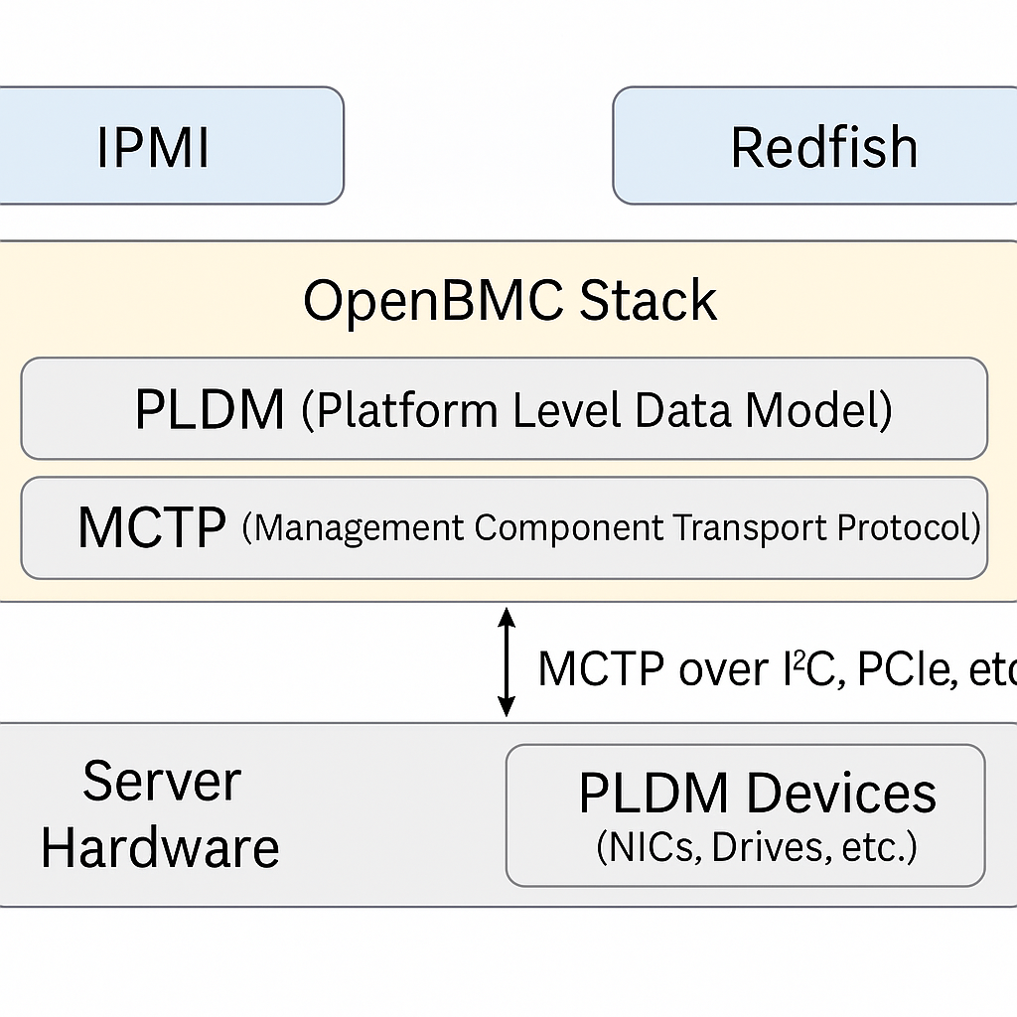
How PLDM Communicates via MCTP

Slide 9
USE CASES
IPMI: System admin remotely powers ON/OFF a server using ipmitool over LAN via OpenBMC.
Redfish: Monitoring software queries Redfish API to check fan speeds and CPU temperature in JSON format.
PLDM: OpenBMC performs firmware update of a BIOS chip using PLDM over MCTP.
MCTP: BMC communicates with an NVMe drive over SMBus using MCTP to exchange PLDM sensor data.

Slide 10
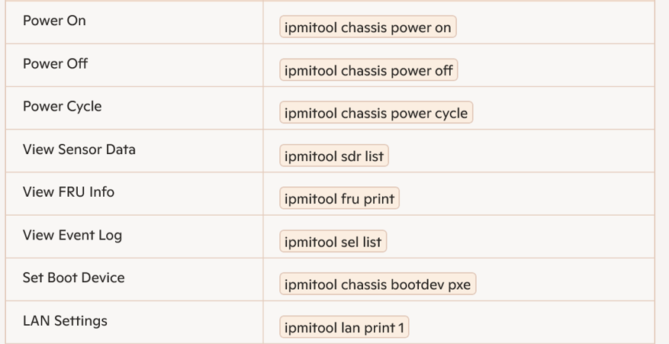
IPMI Commands

Slide 11
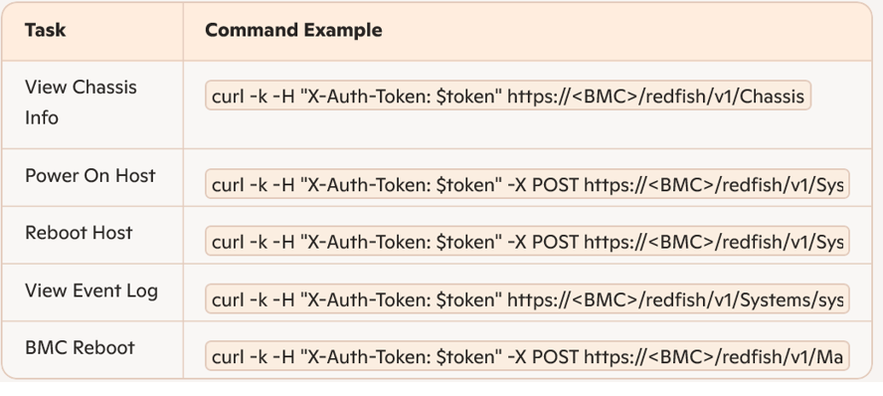
Redfish Commands

Slide 12
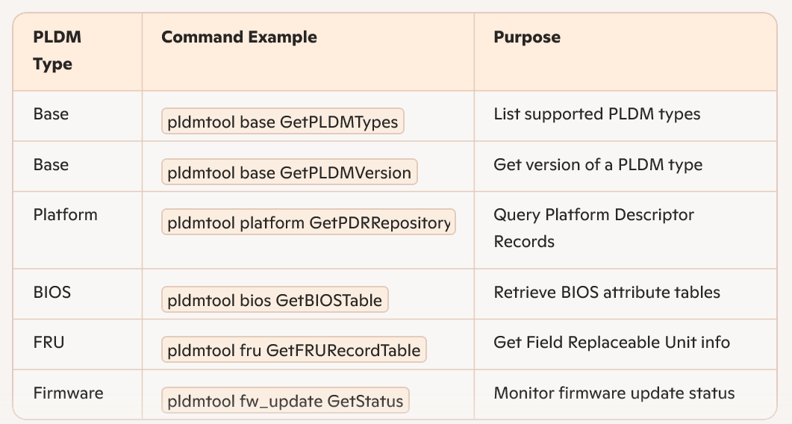
PLDM commands

Slide 13

THANK YOU

